Slide 1
Analytical Instrumentation
Prof. Sujit M. Deokar,
Department of Instrumentation Engg.
Vishwakarma Institute of Technology, Pune
Lecture 02 :
Atomic Structure

Slide 2
Index
Atoms in Hindu Scriptures
John Dalton’s Theory
Fundamental Components of elementary particles
Modern Atomic theory
Nuclear Reaction
Electronic Structures of Atoms

Slide 3
Recap
Introduction
The Cutting edge technology
Need of Analytical Instrumentation Engineering
Applications of Analytical Instrumentation
Challenges
Methods

Slide 4
Atoms in Hindu Scriptures
The descriptions of molecules and atoms and electrons have been given as kana, paramanu and Anu
A kana is an aggregate of smaller particles called as Anu. It is not visible to the naked eye, but it is capable of independent existence
Paramanu is the smallest discrete particle capable of independent existence, but not visible to the naked eye. Paramanus are the essential components of all the atoms, all the things we see around us.
The power of paramanus and Anus was utilized in warfare as Astras.

Slide 5
John Dalton’s Theory (1802)
The matter is composed of tiny real particles called as atoms, which are indivisible; they cannot be created nor destroyed.
Atoms of each pure substance are identical in nature, weight and size and other properties also. Atoms of one pure substance differ in weight and other characteristics from those of other substances.
Atoms in definite numerical proportions results in chemical combinations of compounds.

Slide 6
Continue
Subsequent developments in science led to the expansion of atomic theory and experimental data generated by a number of scientists, such as Michael Faraday, Rutherford, J. J. Thomson and other peers with the discovery of electrons, X-rays, radioactivity, nuclear reactions and other subatomic particles.
The electrons are made up of small energetic particles, whose existence was proved by Sir J. J. Thomson.
Sir William Crookes in 1879 proved theory of electron using highly evacuated discharged tubes.

Slide 7
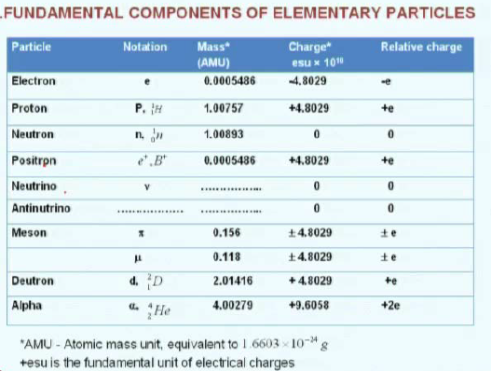

Slide 8
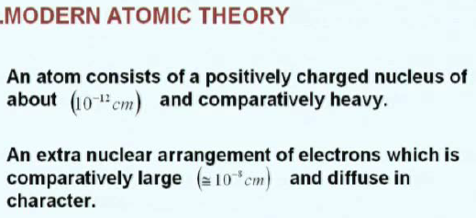



Slide 9
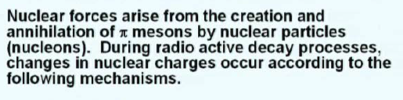
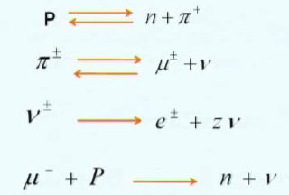
Continue..

Slide 10
Continue…
Nuclei with 2, 8, 20, 28, 50, 82 and 126 neutrons or protons together are especially stable. These so-called magic numbers represent closed shells of the nucleons
For a given element with Z protons, a number of species may exist with the same number of protons, but varying in the number of neutrons. These are known as isotopes. Such elements exhibit the same chemical properties, but differ in the atomic weight and are called isotopes.
Nuclei of the same mass number, but differing in charge also exist, which are called as isobars. They have the same mass number, but differ in the charges & chemical properties, etc.

Slide 11
Nuclear reactions
Capture reactions, particle-particle reaction –
They come and hit each other and then energy could be released;
Fission reactions –
The fission reactions means A substance getting decomposed to produce protons, neutrons and other things, radiations, etc
Spallation reactions and fusion reaction –
Nuclear fusion – all of you must have heard, which is also A source of nuclear energy, that is, electrical energy in the ultimate use.

Slide 12
Electronic Structures of Atoms
Sir J. J. Thomson proposed the corpuscular theory of matter.
Rutherford modified this theory that electrons revolve around the nucleus.
Niels Bohr, a great physicist of our times – he proposed a radically different view of the atomic structure based on the optical spectrum of hydrogen

Slide 13
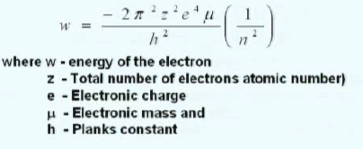
Electrons are best described in terms of four quantum numbers. That is a principle quantum number n and orbital quantum number l, magnetic quantum number m and spin quantum number denoted as s.
The exact equation is something like this
Principle quantum number may have values from n = 1to infinity; of course, infinity means where an electron cannot be found, that is, an ion. In actual practice, it can vary from 1, 2, 3, 4, 5, etc.

Slide 14
Next Lecture on:
Quantum Designation for electrons
Orbital Quantum Numbers
Magnetic Quantum Numbers
Spin Quantum Numbers
Physical Properties of Electromagnetic Radiation

